Slide 1
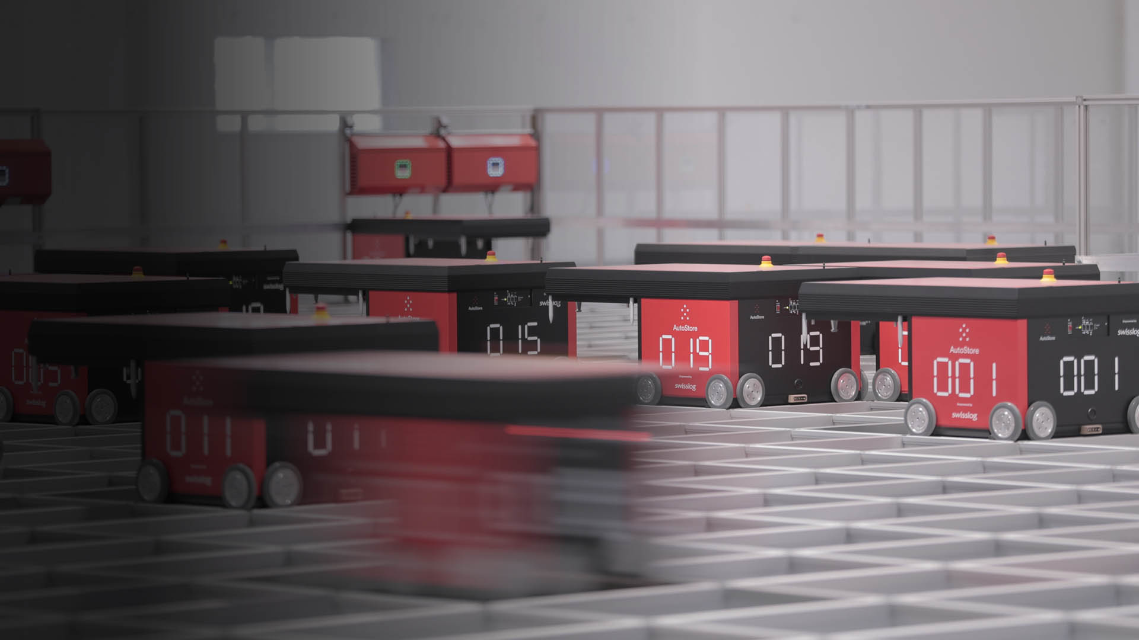

AI use cases : NBO & personalized search
Hi! PARIS – Capstone
19 01 2023

Slide 2
Agenda
1. Introduction to Rexel
2. Use case 1 : Personalized search
3. Use case 2 : Next Best Offer

Slide 3
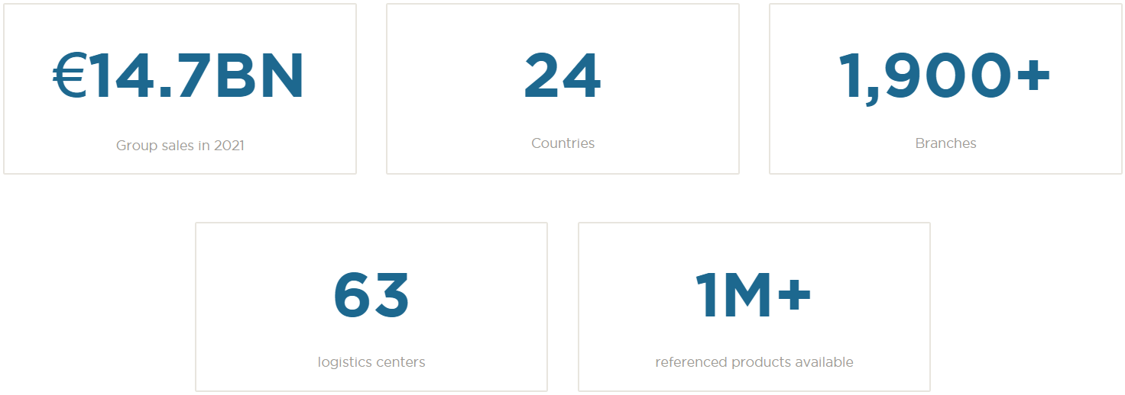
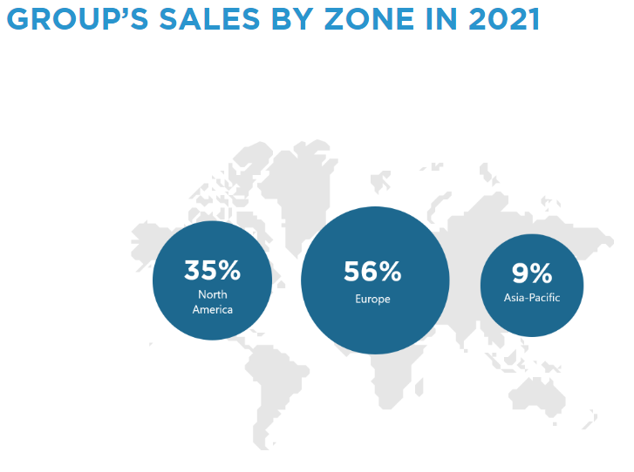
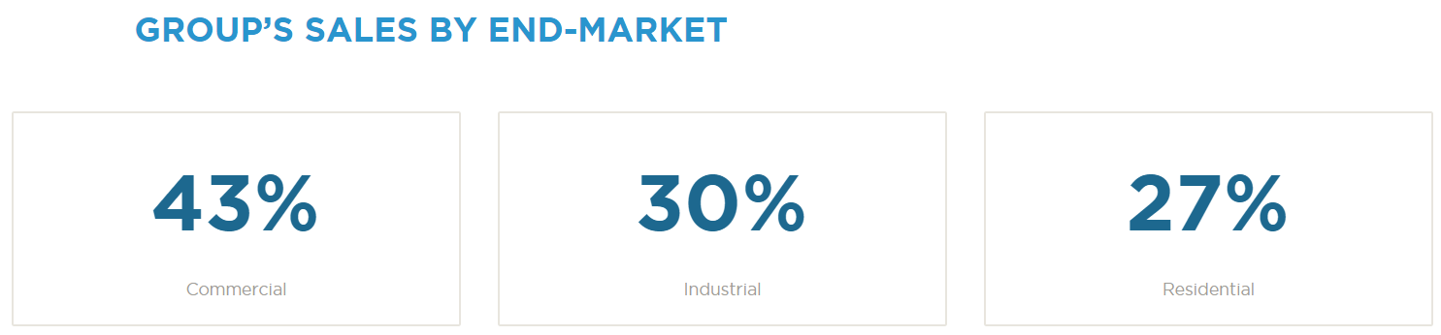
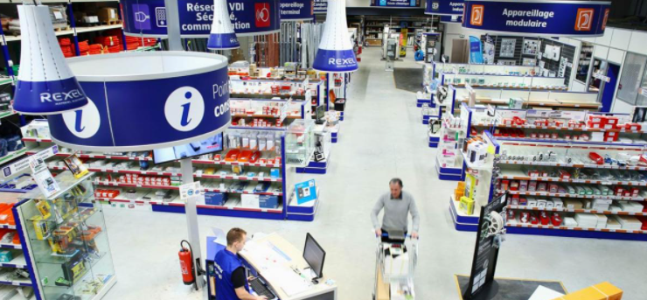

Rexel overview

Slide 4

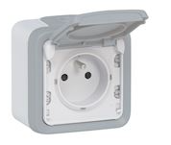
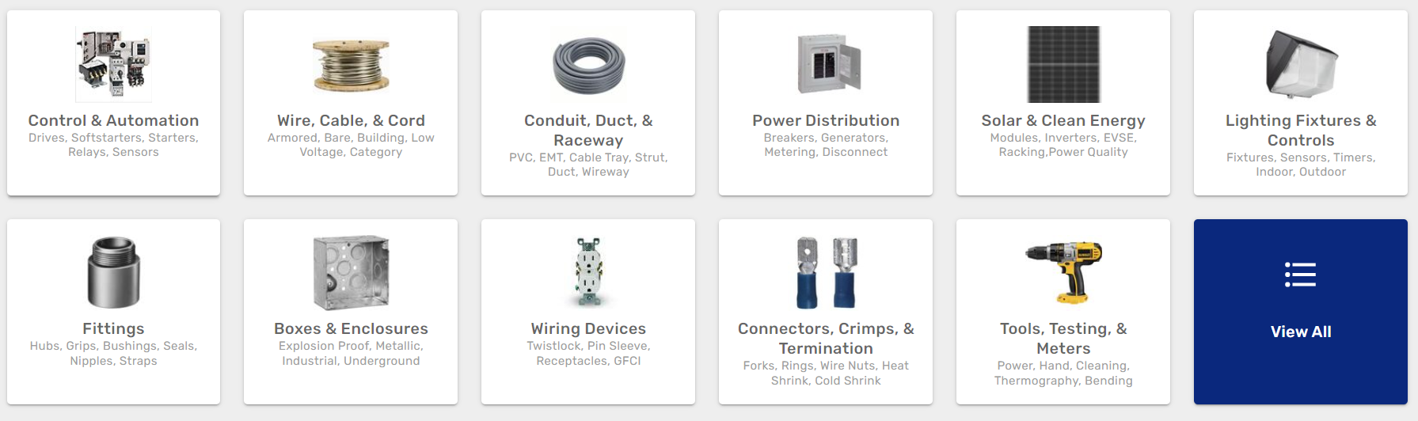

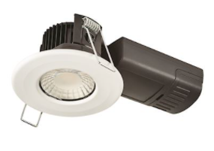
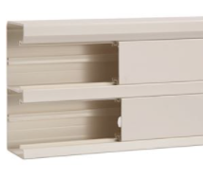
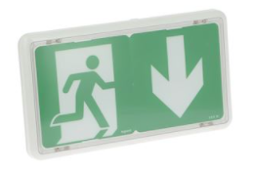
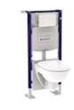
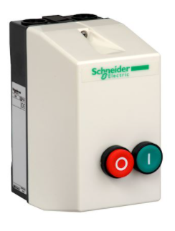
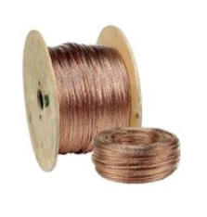


Rexel overview

Slide 5
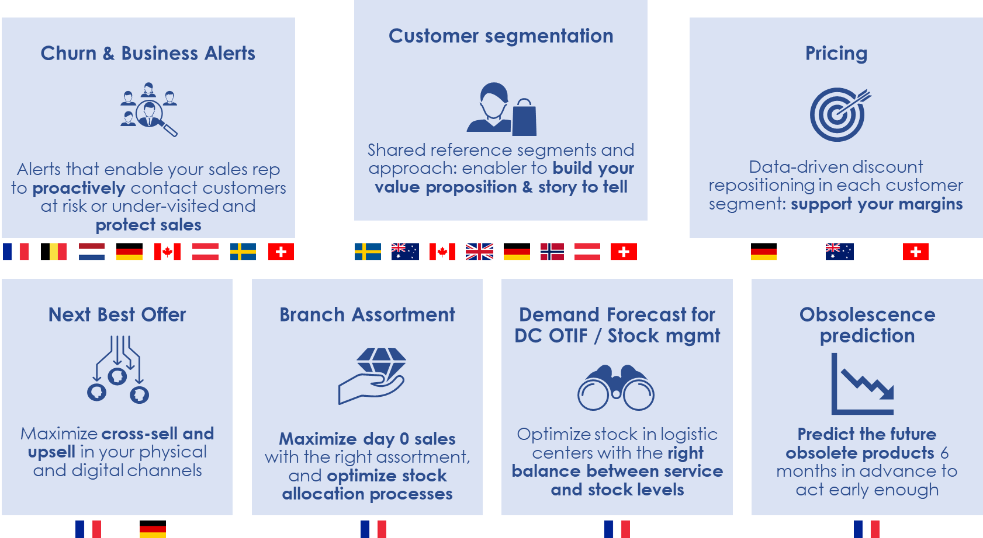
How AI help Rexel business?
We build Artificial Intelligence solutions to accelerate our transformation and are working with 11 countries

Slide 6
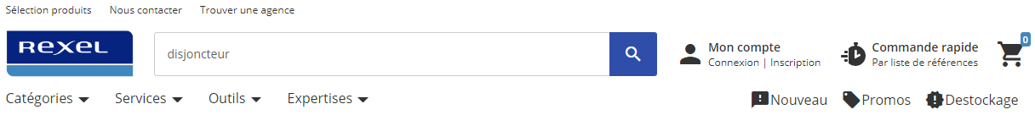

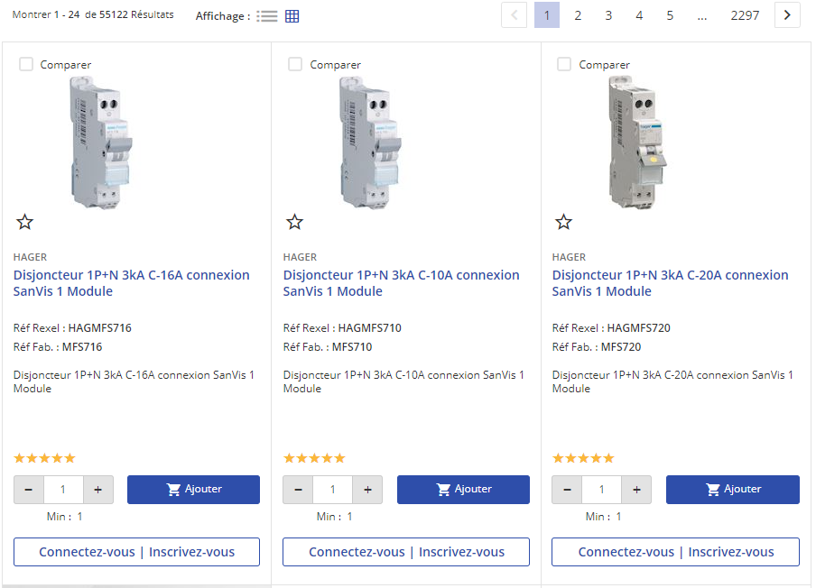
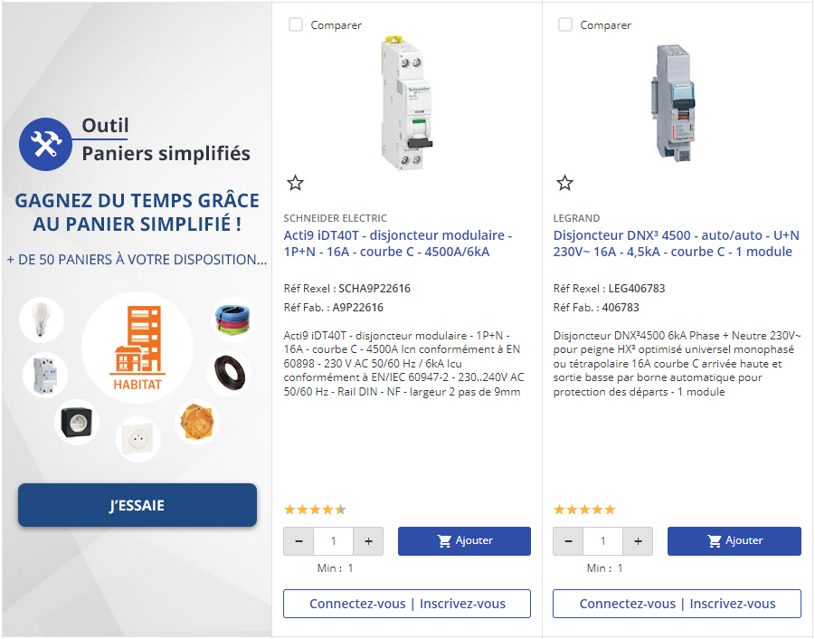
Personalized Search | How search is working ?
Results of the query « disjoncteur »
1. Query: Search Keyword
🔍 Rexel Search Engine (SOLR)
2. Product List Page (PLP)
2*: Only top 6 products are shown here among 24 of the first page

Slide 7
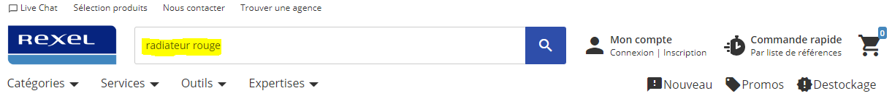
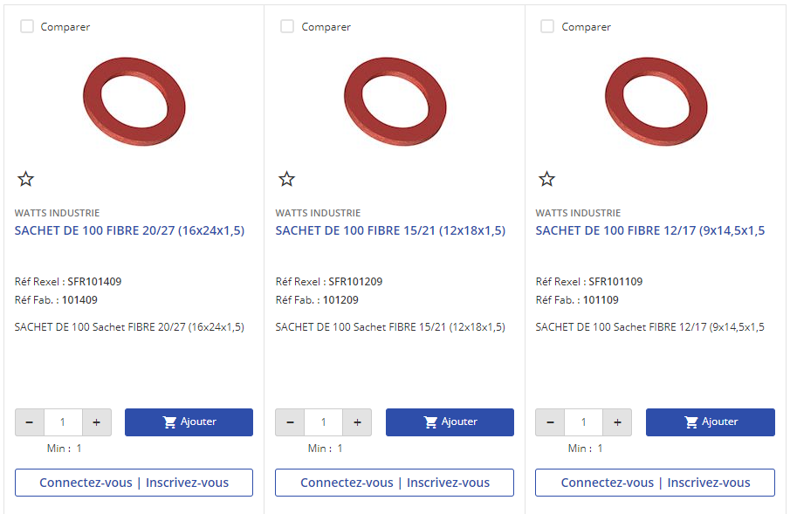
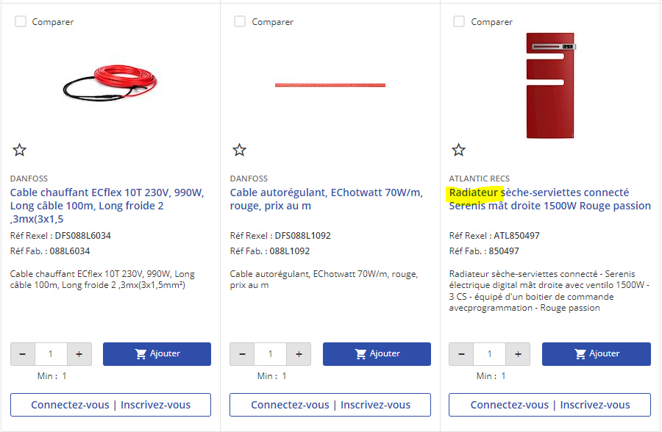
Personalized Search | Cases where re-ranking might be helpful
Results of the query « Radiateur rouge »
Top 3 shown products at the page 1
Bottom 3 shown products at the page 1
. . .
Avg Click Position = 24
1
2
3
22
23
24
💡 The first 23 shown products contain only red objects and only the 24th is a « radiateur » 🚀By knowing that the last product was clicked/added to cart, a reranking might be done to place if at top of the list

Slide 8
Personalized Search | Cases where re-ranking might be helpful
Results of the query « Radiateur rouge » - AFTER Learning To Rank
Top 3 shown products at the page
Bottom 3 shown products at the page
. . .
1
2
3
22
23
24
Avg Click Position = 1
Minimizing Average Click Position

Slide 9
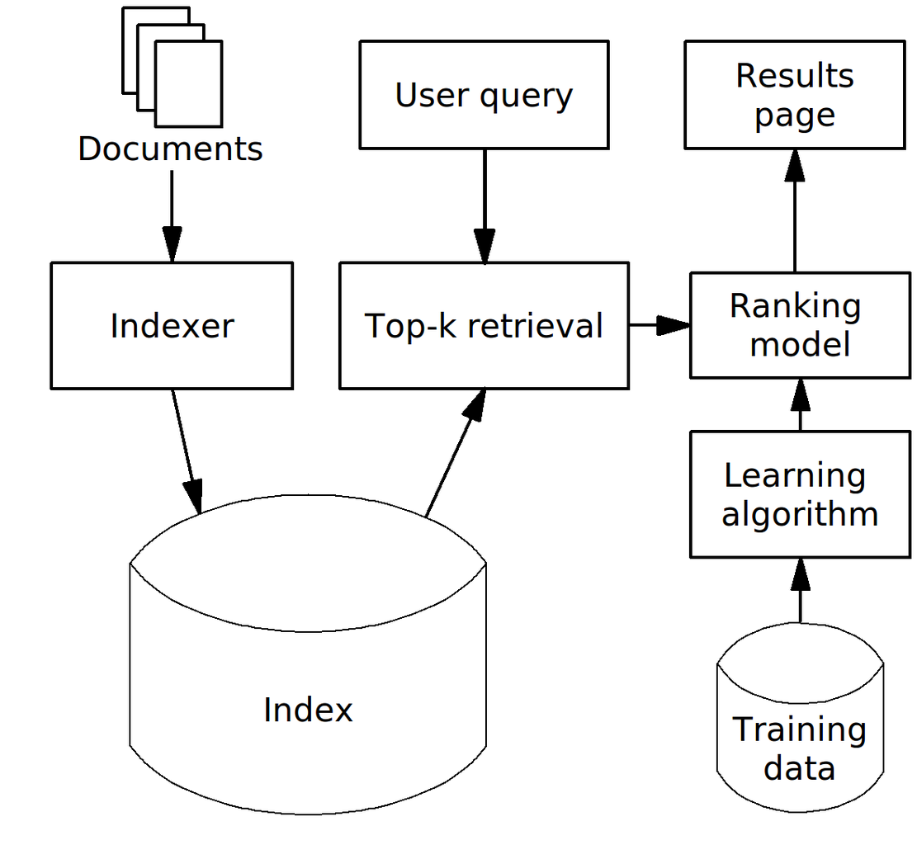
Personalized Search | Learning To Rank: a data driven approach
Rule-based ranking
Machine-Learned Ranking
products
products
Business re-ranking rules
CHALLENGE SCOPE
🚀 Objective: Develop a model that helps re-rank the products of search results

Slide 10

Learning To Rank | What training data do we use ?
We Consider different kinds of information to re-rank the products
Product
Product_id, product_name, product category, GA interactions (click, Add to cart ..), past transactions…
2 Data sources
Client
Client_id, Client segments, GA interactions, past transactions…
Data level
Google Analytics (GA)
Local DB
Client_id, Product_id, product_name, GA interactions, past transactions…
Client x Product
Search queries: clicks, add to cart, …
Clients, Products, Transactions …
Query
Query_id, Search Keyword
💡 Data Volumetry constraint: Only the most relevant features need to be kept → Avoid increasing the Search engine response time

Slide 11

Learning To Rank | Train & Predict approach
Rerank the products by predicting product’s future interaction
Characteristics / Features (12M)
Target (1W)
Search Data
Client Data
Product Data
Client x Product Data
Phase 1: Learn (Train)
Phase 2: Predict & Rerank
(to test or for real application)
Characteristics / Features (12M)
Target (1W)
Model Evaluation after LTR
Minimizing Average Click Position
Target*: Is_interaction: whether or not the product will be clicked/added to cart Before*: Products with interaction are placed on average at the position 4,3
Before
After

Slide 12
Final Take-away | Minimizing Avg Click Position with LTR
Client : X
Segment CLI : Y
Search Text : « Z »
Before LTR
After LTR
Clicked products
At position 1 and 2
Minimizing Average Click Position
Clicked products
At position 23 and 24

Slide 13
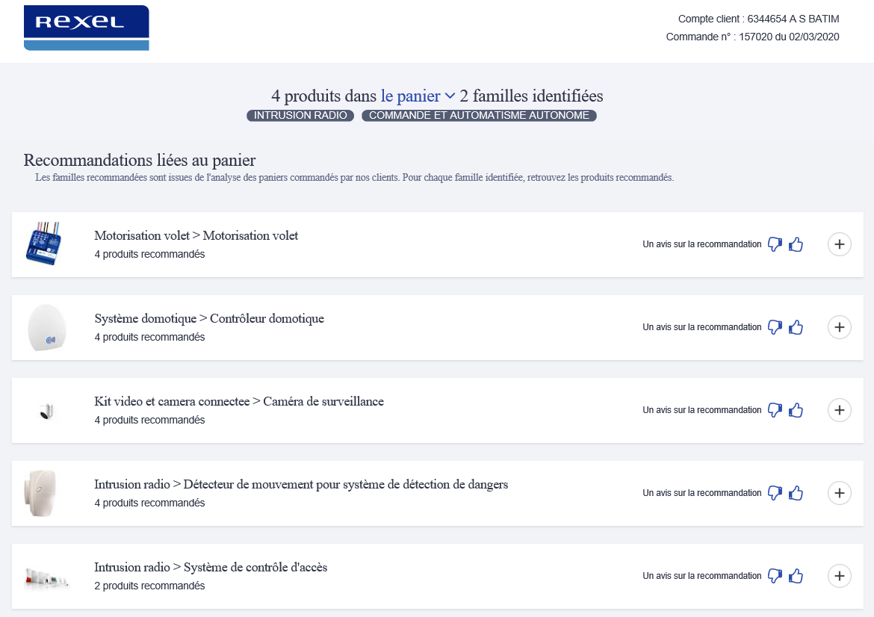
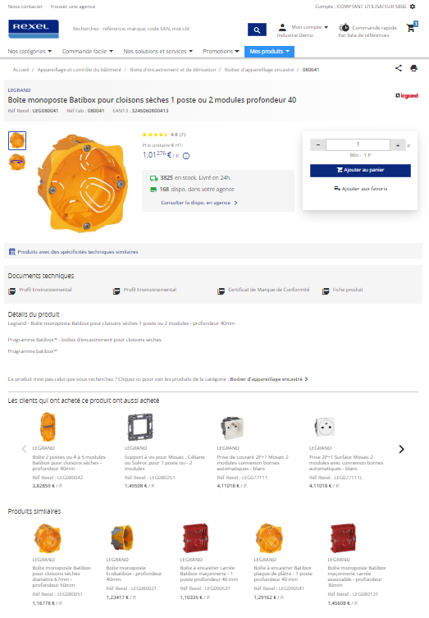
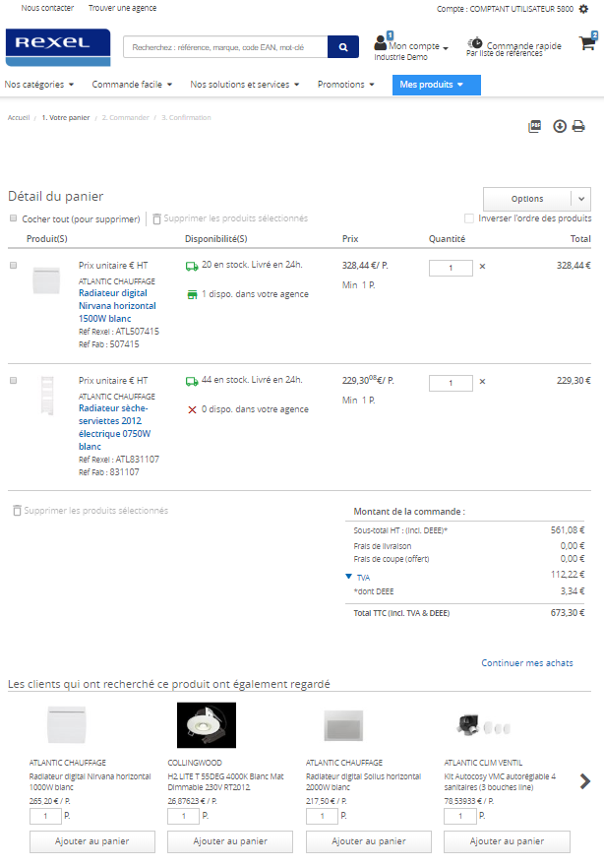
Multiple Product Recommendations are relevant depending on the sales stage and the channel
Sales stage & relevant reco
Filling the cart
Cart filled
Substitution
Complementary products
Complementary products
Branch / Phone
Under development
Under development
Channel
Webshop

Slide 14

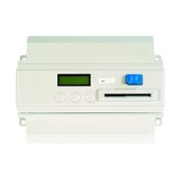
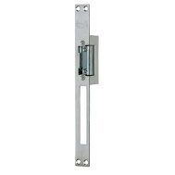
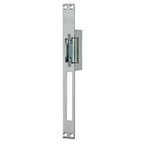
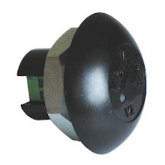
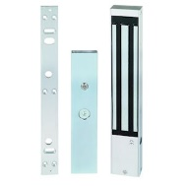
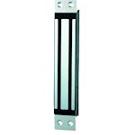
Based on customers’ past purchases, NBO predicts the type of products and references that are missing from the shopping cart
Types of products in the customer cart / request for quotation
A complete shopping cart based on past purchase activity
Types of products missing
References to recommend
Portier collectif
Centrale gestion contrôle d'accès
Portier collectif
Centrale gestion contrôle d'accès
Gâche contrôle d'accès
Gâche contrôle d'accès
CDVI Gâche + têtière symétrique émission 2 temps 12V AC/DC
Lecteur contrôle d'accès
Lecteur contrôle d'accès
Ventouse contrôle d'accès
Ventouse contrôle d'accès
Urmet France Ventouse Encastrée 300K +Led+

Slide 15
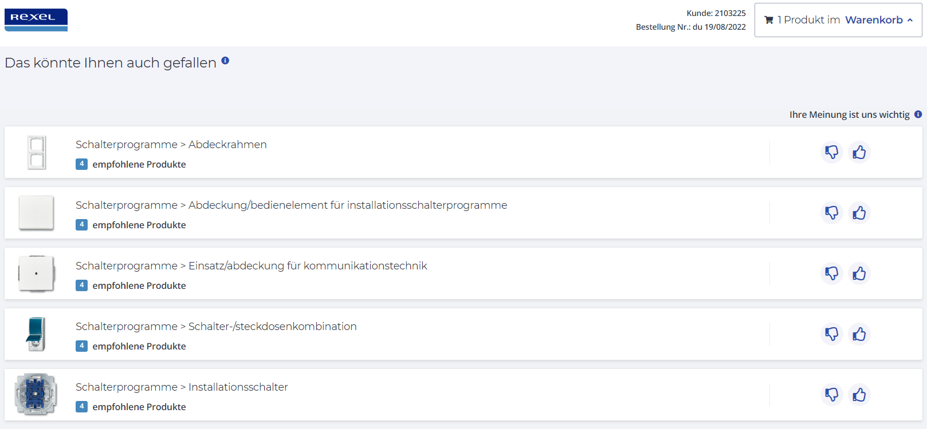
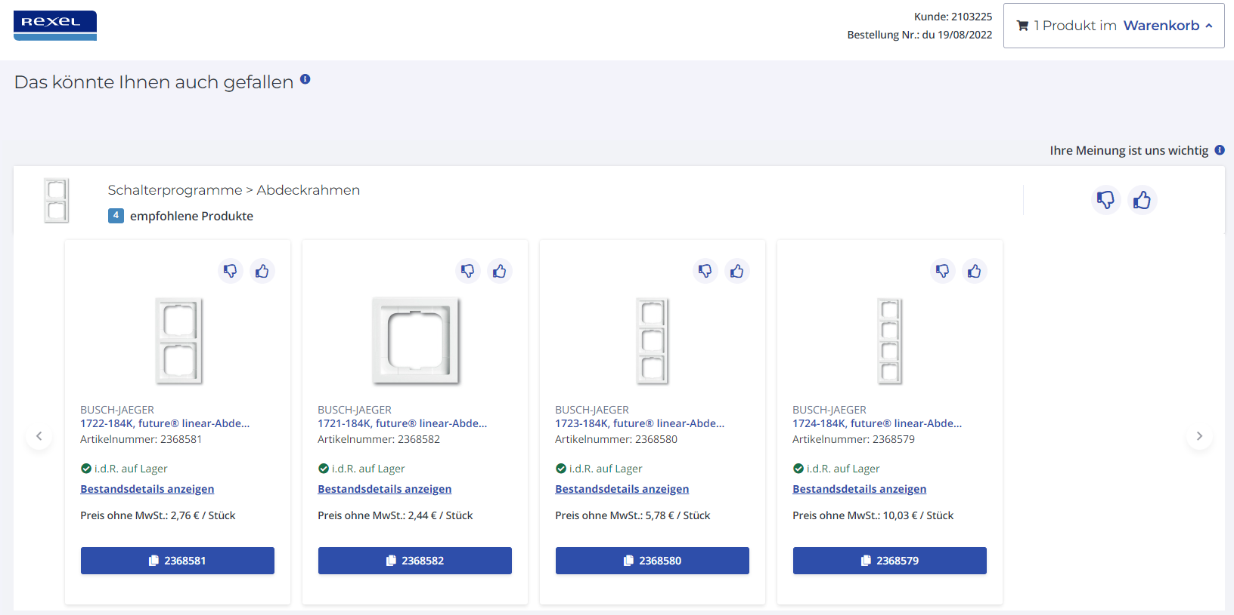
For the sales teams, we recommend product categories complementary to the basket before zooming on specific products
STEP 1 :
STEP 2 :
Real time recommendation system
The sales rep can like or dislike a recommendation. In case of a dislike, he can recommend a specific category or product reference

Slide 16

Neural network architectures are used to perform recommendations
Product Category
Product Reference
Guiding matrices
(automated + manual adjustments)
Compatibility Matrix
Coocurrence Matrix
Rule-based models
(statistical)
ContextMiner
fpmax algorithm from the ARL
Create a "context" that represents product categories that are frequently bought together
ProductMiner
apriori algorithm from the ARL
Generate frequent itemsets of products based on the transactional data
Core Recommender
or
or
Deep learning models
(neural network)
LSTMsRecommender
RNN architecture to deal with sequential data
Learn the importance of an element’s order in a sequence
Prod2VecRecommender
CBOW neural network architecture
Learn product associations from a large transactional database by creating embeddings
Boost
Stock availability
(+ tbd: supplier boost, margin boost, overrides)
17

Slide 17
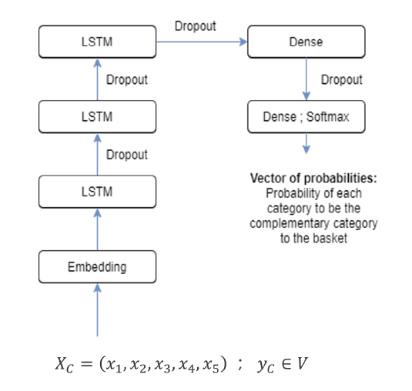
LSTMsRecommender: Architecture chosen for category recommendation
A basket is considered as an ordered sequence of categories, we predict the complementary category to a given basket.
Embedding layer: Initialize the embeddings of categories to reduce the memory use of the model.
Stacked LSTMs: Helps get more complex relations/contexts between categories.
Last Dense layer: The softmax activation gives the probability of each category.
Dropout: Avoids overfitting by dropping out a given sample size of cells.
Loss: Categorical Cross Entropy Loss for multilabel calssification tasks.
Xc : Set of historical baskets.
yc : the true category to be predicted

Slide 18
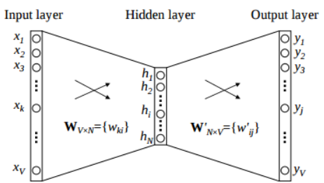
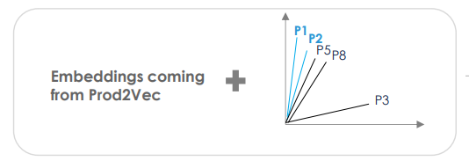
Prod2vec: Embeddings’ based model for product reference recommendation
The output layer gives the probability of being the nearby product for every product in the vocabulary.
Once this model is trained, we can easily extract the embeddings which are learned weight matrix WV x N.
V : size of the vocabulary.
N : Size of the embeddings.
Products with nearby embeddings are more likely to be bought in the same context.
Example of recommandation for a basket containing 2 products : P1 and P2
P5 and P8 are the closest 2 products to P1 and p2.
We then recommend P5 and P8.

Slide 19
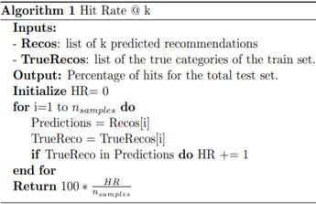
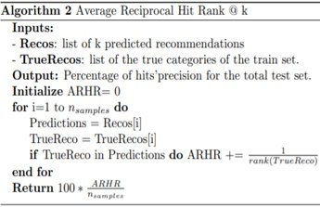
Models’ performance at both levels is assessed with HR and ARHR
Hit Rate@k : the % of basket for which the correct answer is in the top K recommendations.
Average Reciprocal Hit Rate@k : A variant of Hit Rate, considers the rank of the recommendations.

Slide 20
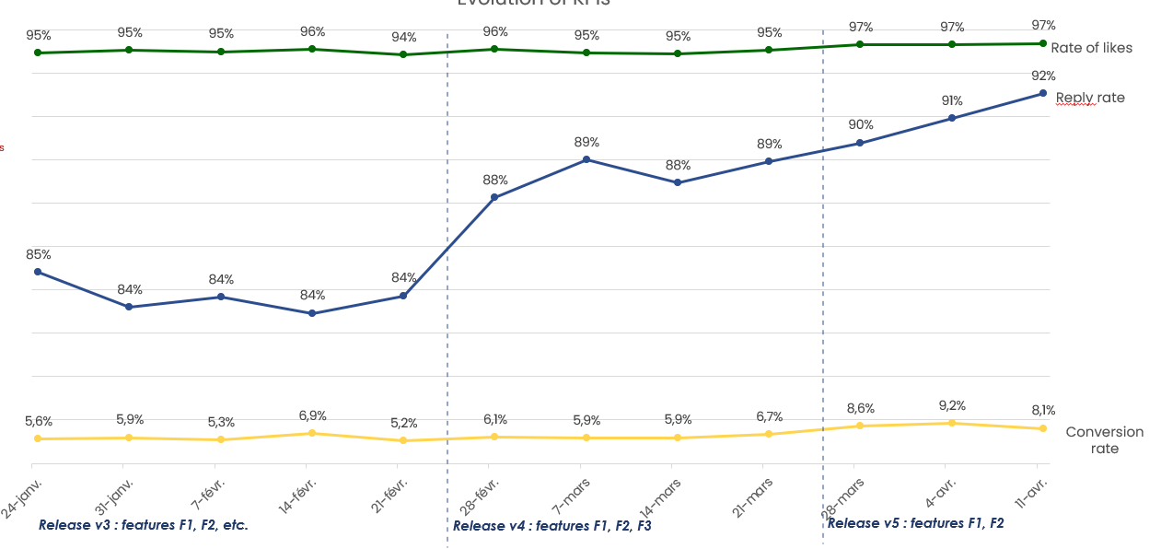
NBO – KPIs monitoring
Perfomance KPIs of the model in PROD:
Financial KPIs of the solution in PROD

Slide 21
Thanks for your attention!
Any questions?
22
22

